Slide 1

CIS-4951
With Dr. Bruce Maxim
Sky Socket
Post Mortem
Presentation
Demetrius Johnson
Olivia Pellegrini
Ryan Sauer
Jonathan Schall
Notes:
olivia

Slide 2

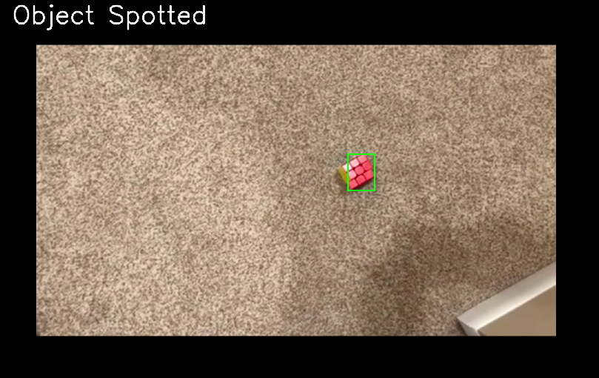
What went right?
Communication between team members and client
Followed to our schedule
Reached ours goal of what we wanted to accomplish for Senior Design I
Drone flying
Running OpenCV object detection program
Car can drive
Notes:
olivia

Slide 3
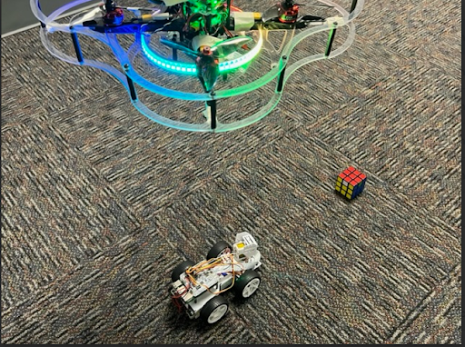
What went right?
'Extending Automotive Vision System by Unmanned Aerial Vehicles' accepted for the IEEE MOST 2023 Demo and Poster Session
Performed well at the Senior Design Competition
Notes:
olivia

Slide 4
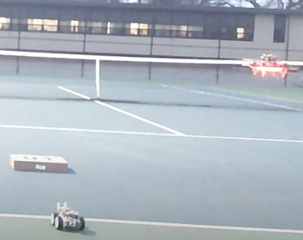
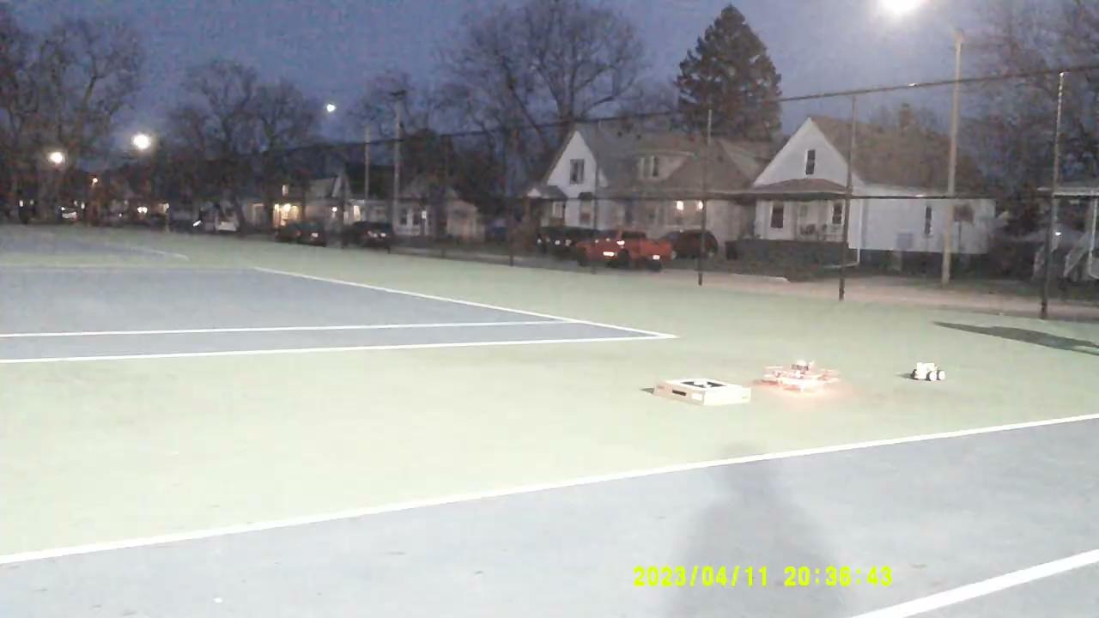
What went wrong?
Drone required continuous repairs after constant failures
Took some time to get the drone flying and to get the programs working on the RPi image
Limited frame rate and lens distortion on the camera that may cause more issues later
No place to run experiment on campus yet
Notes:
jonathan

Slide 5
Lessons learned/process improvement suggestions:
Learn to have a flexible schedule and be willing to make changes
Either set goals low or create expectations to be done ahead of time
Needed a proper procedure for creating changes in our schedule
Notes:
jonathan

Slide 6
Why is lifelong learning important for computing professionals?
It is important for developers to keep up with the technological advancements that are always taking place
Especially important in Cybersecurity where attackers are always learning new ways to conduct attacks and exploit vulnerabilities.
There is knowledge to be gained in every CS field
There is knowledge we don't know is knowledge to be known yet
Notes:
ryan

Slide 7
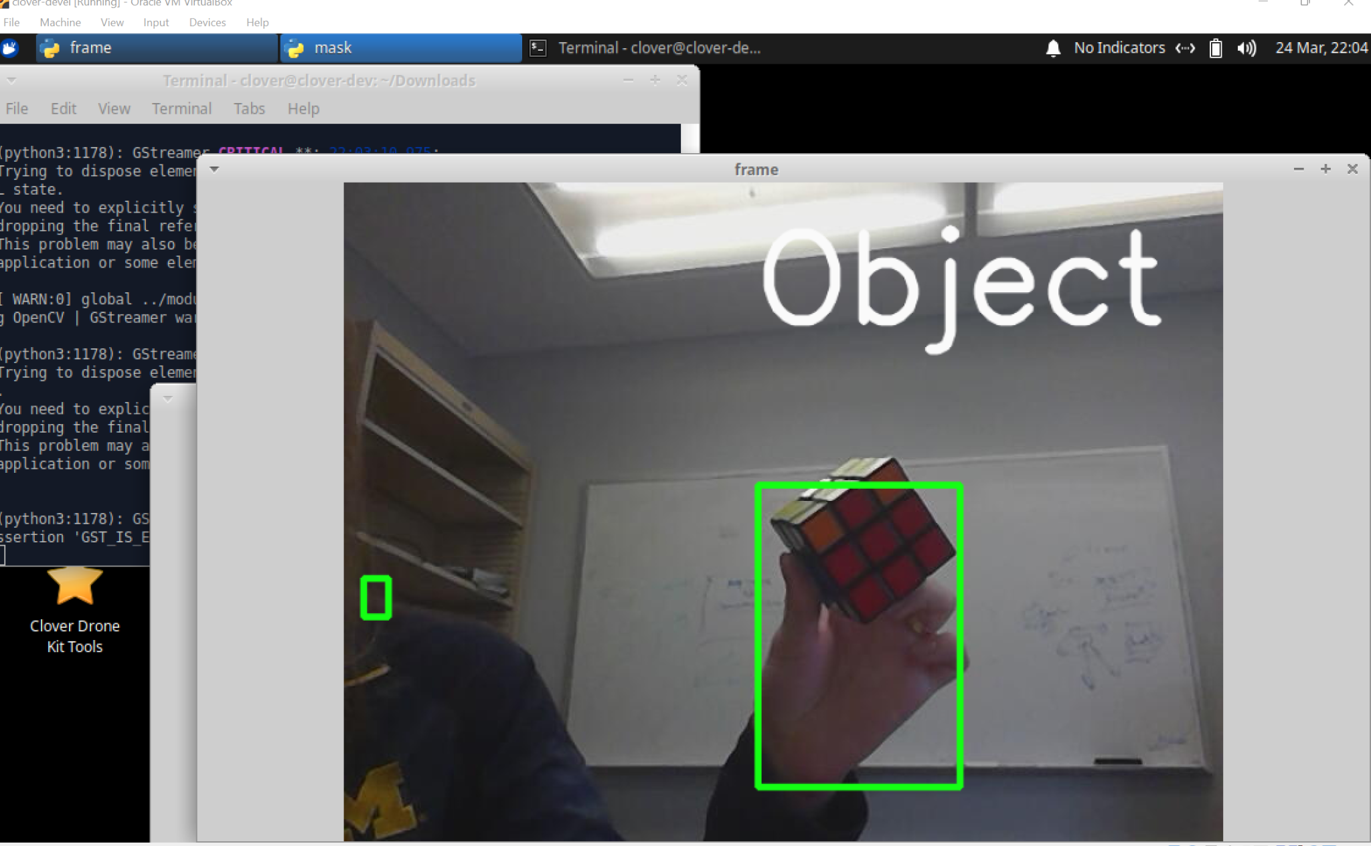
How did you use knowledge and skills from your major on this project?
Learn how to use OpenCV with previous Python experience
Improved our Linux skills using a VM to run the program
Utilized socket programming from networking course
Utilized edge computing concepts
Implemented software development concepts
Notes:
ryan

Slide 8
Contact Us
Demetrius Johnson
meech@umich.edu
Ryan Saur
sauerr@umich.edu
Jonathan Schall
jcschal@umich.edu
Olivia Pellegrini
opelle@umich.edu
Dr. Zheng Song (Client)
zhesong@umich.edu
Dr. Bruce Maxim
Senior Design Professor/Director CIS-4951 Winter 2023
bmaxim@umich.edu

